Slide 1
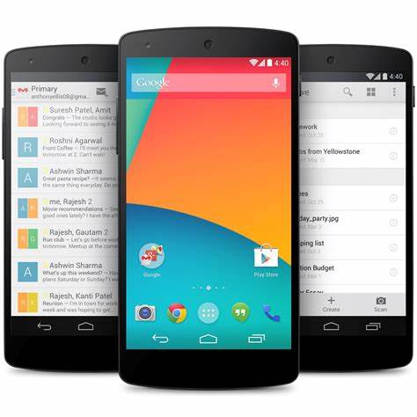



Client
Analyze Health Records
Food type Label Segmented Images
2
Nutrient
Information
1
3
4
Research Community
5
User Confirmation And Adjustment
User Confirmation
Image + Metadata

